Slide 1
Writing Expectations on the MCAS English Language Arts (ELA) Tests
Office of Student Assessment Services
December 12, 2022

Slide 2
Presenters
Amy Carithers, Manager of ELA Test Development
Danika Ripley, Grades 3, 4 and 5 ELA Test Developer

Slide 3
Logistics for this Session
Use the Q&A feature to ask a question.
Type your questions anytime, but we may not answer them in real time as some questions may be covered during the presentation.
Email student-specific questions to mcas@doe.mass.edu instead of asking here.
We will answer some questions aloud at the end of this session, and we will email the Q&A afterwards.
This session is being recorded and will be available in about a week in the MCAS Resource Center, along with the slides.
Slides were also emailed out beforehand, and are being posted in the chat.
Closed captioning has been enabled for participants who need it.

Slide 4
Poll Question #1
What is your current role?
Classroom teacher
Instructional coach
Curriculum coordinator
Administrator
Other

Slide 5
Goals of this Presentation
To communicate a deeper understanding of MCAS writing expectations and how these expectations connect to writing and language standards
To give participants the opportunity to review student work samples and understand how MCAS writing questions are scored
To provide information about online resources, including test designs, released questions, and annotated student work

Slide 6
2022 Gr. 3-8 ELA Results
Performance on the Spring 2022 ELA tests decreased from 2019 to 2022
Grade​ | Percent Meeting or Exceeding Expectations |  |  | Change in Percent Meeting or Exceeding Expectations | Change ​ M/E 21-22​ | Change​ M/E 19-22​
 | 2019​ | 2021​ | 2022​ | 2019-2021 | 2021-2022 | 2019-2022
3-5​ | 53​ | 49​ | 41​ | -4​ | -8​ | -12​
6-8​ | 51​ | 44​ | 41​ | -7​ | -3​ | -10​
3-8​ | 52​ | 46​ | 41​ | -6​ | -5​ | -11​
Decline in essay writing performance
The number of test takers receiving a score of 0 points increased from 19% in 2019 to 31% in 2022
The average points scored per essay decreased in grades 3-8 with larger decreases seen in grades 3-5

Slide 7
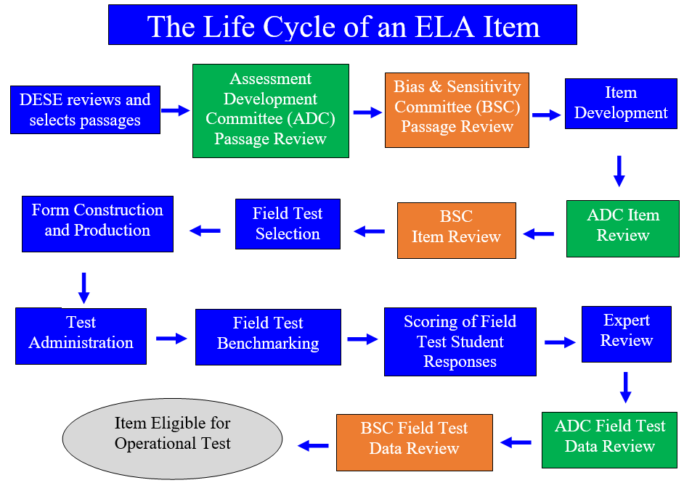

Slide 8
Benchmarking Process
Scoring Guide (rubric)
outline general expectations at each score point
Anchor Papers
selected from field tested questions
represent a range of real student responses based on the scoring guide (rubric) and scoring notes (educator committees assist with the development of these notes)
Annotations
added to each anchor paper to articulate the expectations for student performance

Slide 9
Scorer Training
For each MCAS essay, scorers:
participate in essay-specific training
must qualify to score each essay question
use the passage, question, anchor papers, scoring notes, annotations and scoring guide to score each essay
are monitored by measures such as read-behinds and embedded responses to ensure accuracy

Slide 10
Scoring Guides (Essay Rubrics)
Outline general expectations at each score point
Two-trait rubric:
Idea development (Writing reporting category)
Conventions (Language reporting category)
Number of points per essay:
Idea Development: 4 points (grade 3-5) or 5 points (grades 6-8 and 10)
Conventions: 3 points (all grades)

Slide 11
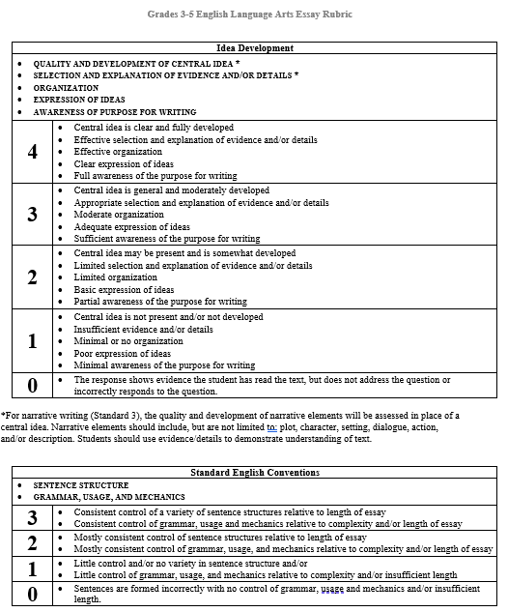
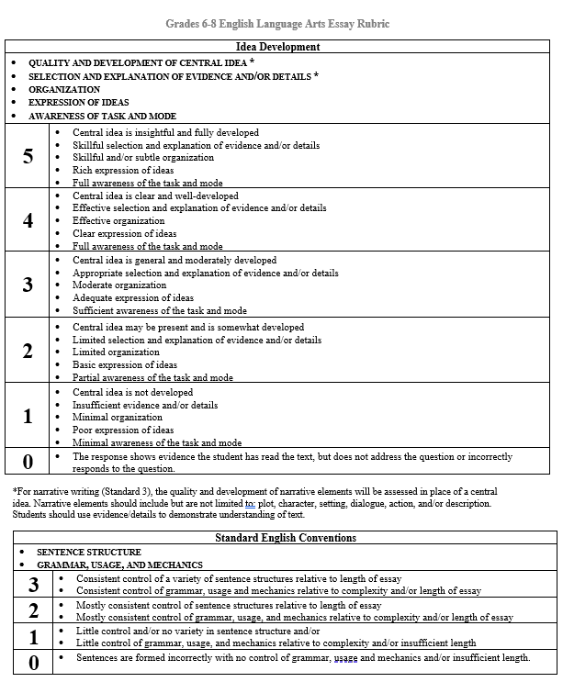
Rubrics
https://www.doe.mass.edu/mcas/tdd/ela.html?section=rubrics

Slide 12
Scoring Guide
Idea Development | Conventions
quality and development of central idea * selection and explanation of evidence and/or details * organization expression of ideas awareness of purpose for writing (task/mode – g6-8 and 10) | sentence structure grammar, usage, and mechanics
* For narrative writing, the quality and development of narrative elements will be assessed in place of a central idea. Narrative elements should include, but are not limited to: plot, character, setting, dialogue, action, and/or description. Students should use evidence/details to demonstrate understanding of text.

Slide 13
Poll Question #2
What grade-level band do you primarily work with in your current role?
Grades 3-5
Grades 6-8
High school
All grade levels
Other

Slide 14
MCAS Student Essay Expectations
Essay responses are based on the passage(s) the students read.
Grades 3 and 4: Students respond to one operational essay question.
Grades 5 and above: Students respond to two operational essay questions.
Essays need to address the essay question.
Standardized for each writing type
Contains information for what students should include in their essay responses
Essay responses must be written in the correct mode being asked for in the question (e.g., narrative).
Length of essay response should be multiple paragraphs.

Slide 15
Writing Modes based on State Framework
Based on Massachusetts Curriculum Frameworks
Three Writing Modes
Standard 1: Opinion (grades 3-5) or Argument (grades 6-8 and 10)
Standard 2: Informative/Explanatory
Standard 3: Narrative

Slide 16
Opinion/Argument and Explanatory Writing Language
W.PK-12.1: Write arguments to support claims in an analysis of substantive topics or texts, using valid reasoning and relevant and sufficient evidence.
W.PK-12.2: Write informative/explanatory texts to examine and convey complex ideas and information clearly and accurately through the effective selection, organization, and analysis of content.

Slide 17
Released Grade 7 Essay Question

Slide 18
Narrative Writing Language, Grades 3 and 4
W.PK-12.3 - Write narratives to develop experiences or events using effective literary techniques, well-chosen details, and well-structured sequences.

Slide 19
Narrative Writing Language, Grade 5 and Above
W.PK-12.3: Write narratives to develop experiences or events using effective literary techniques, well-chosen details, and well-structured sequences.

Slide 20
Released Grade 3 Essay Question

Slide 21
Grade 3 Essay Response Example 1
Idea development: 0
Conventions: 1
What I think will happen next is the mother bear will join in on the water fight.And then she will teach the cubs how to hunt for fish in the river.But then they will eat fish that the mothercatched for them.And then they will probably go back to the den and take a little short nap.And that is what I think will happen next.

Slide 22
Grade 3 Essay Response Example 2
Idea development: 0
Conventions: 1

Slide 23
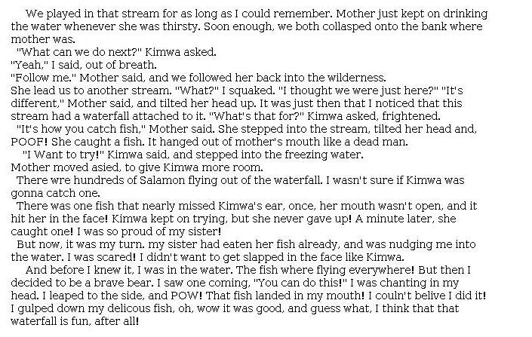
Grade 3 Essay Response Example 3
Idea development: 4
Conventions: 3

Slide 24
Poll Question #3
Have you used the rubrics or student work samples on the DESE website?
I have used them.
I would like to use them, but don’t know where to find them.
I didn’t know they were available to me.
I know that they are available, but I don’t use them.

Slide 25
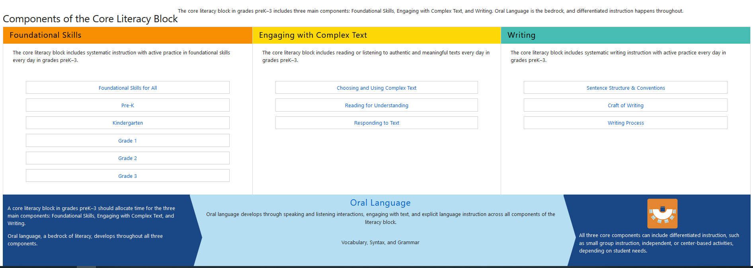
Resources from Mass Literacy
https://www.doe.mass.edu/massliteracy/literacy-block/

Slide 26
Resources from Mass Literacy Website
Writing Component | Web Link
Sentence Structure and Conventions | https://www.doe.mass.edu/massliteracy/literacy-block/writing/structure.html
Craft of Writing | https://www.doe.mass.edu/massliteracy/literacy-block/writing/craft.html
Writing Process | https://www.doe.mass.edu/massliteracy/literacy-block/writing/process.html

Slide 27
Resources on the DESE MCAS website
Resource | Link
Access MCAS headlines and links to MCAS site | https://www.doe.mass.edu/mcas/
ELA Test Designs | https://www.doe.mass.edu/mcas/tdd/default.html
Student Work Samples and Annotations | https://www.doe.mass.edu/mcas/student/default.html
Released Questions | http://mcas.pearsonsupport.com/released-items/ela/
Practice Tests and Tutorial | http://mcas.pearsonsupport.com/student/

Slide 28
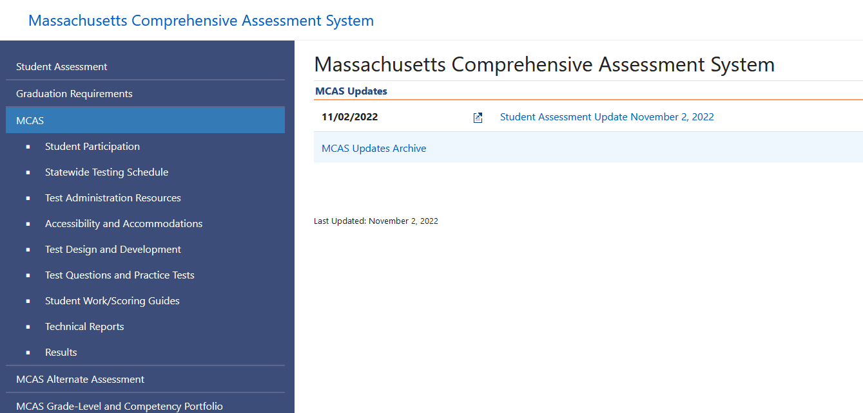
https://www.doe.mass.edu/mcas/default.html

Slide 29
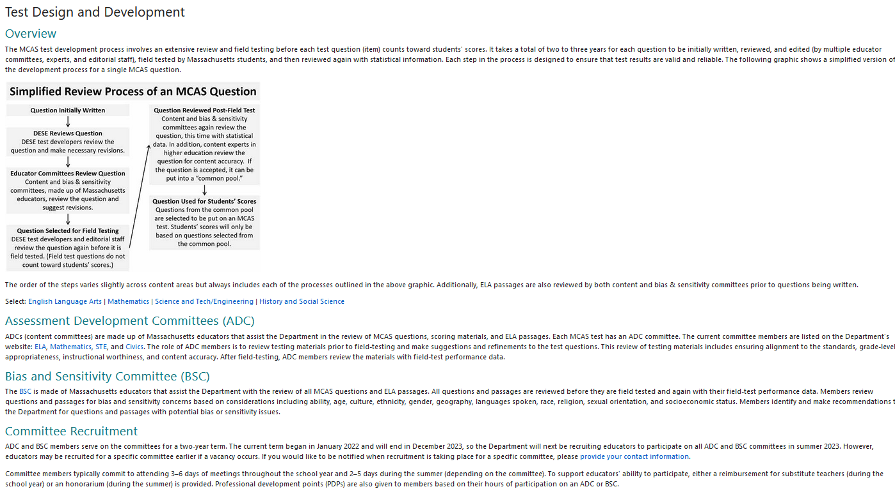
https://www.doe.mass.edu/mcas/tdd/default.html

Slide 30
https://www.doe.mass.edu/mcas/tdd/ela.html

Slide 31
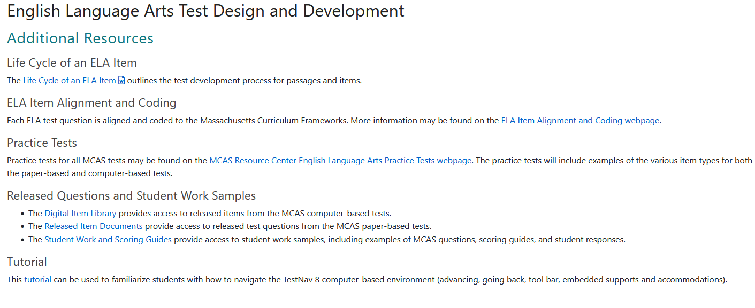
https://www.doe.mass.edu/mcas/tdd/ela.html?section=other

Slide 32
https://www.doe.mass.edu/mcas/student/default.html

Slide 33
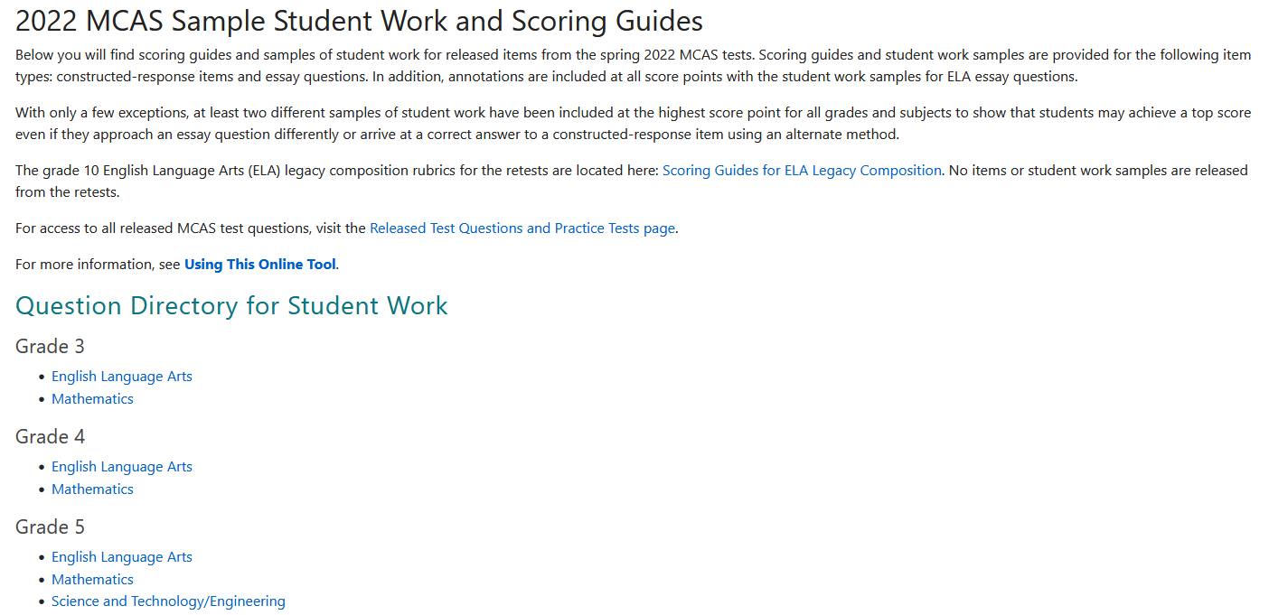
https://www.doe.mass.edu/mcas/student/2022/

Slide 34
https://www.doe.mass.edu/mcas/student/2022/grade5/ela.html

Slide 35
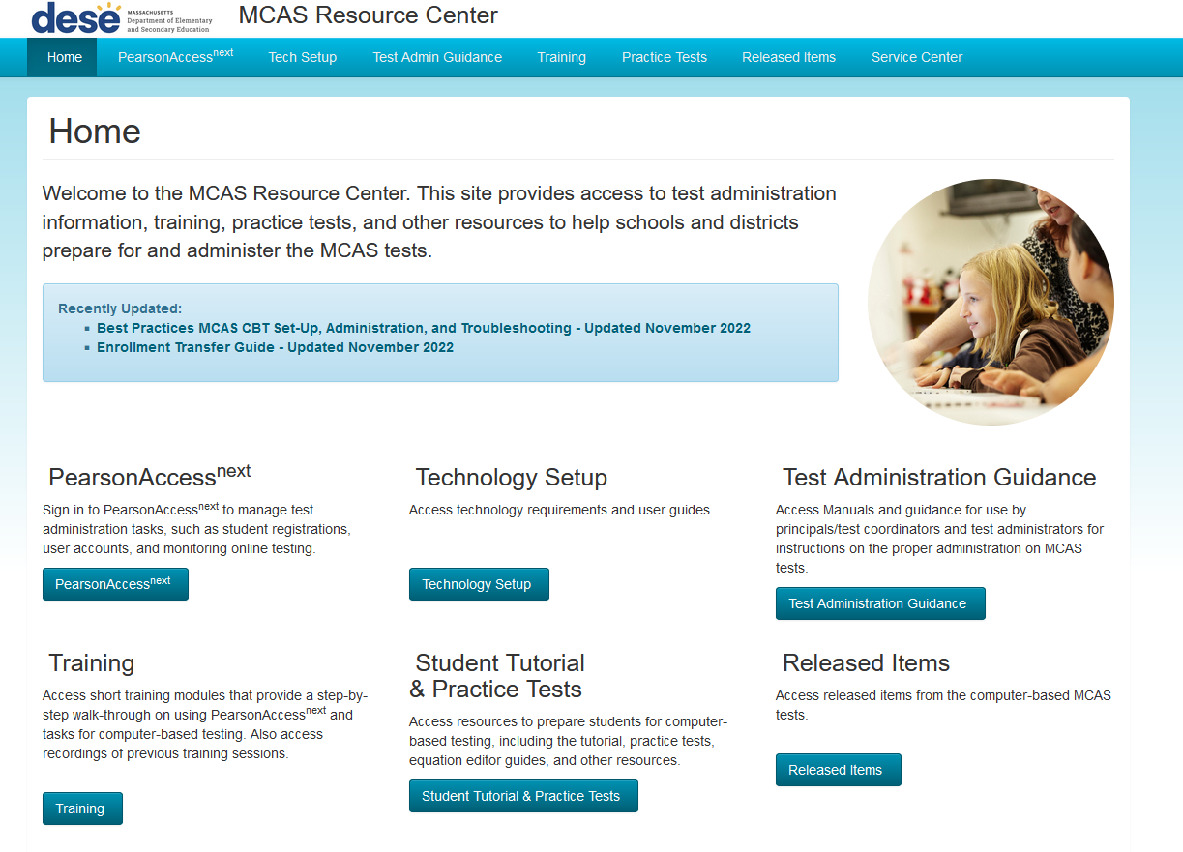
http://mcas.pearsonsupport.com/

Slide 36
Questions and Answers

Slide 37
Email and Phone Support
DESE Office of Student Assessment
All policy questions (e.g., test designs, accommodations)
Web: www.doe.mass.edu/mcas
Email: mcas@doe.mass.edu
Phone: 781-338-3625

Slide 38
Next Steps
Today: Complete the evaluation form.
Responses are associated with the name and email address used to log in.
Email your input to mcas@doe.mass.edu if you have problems accessing or completing the form.
Next week:
Receive an email with the Q&A from this session
Recording will be available

Slide 39
THANK YOU

